Slide 1
Unit-5 – CIE-2 portions
Understanding Computer Forensics

Slide 2

Cyberforensics
Provides digital evidence of a specific or general activity
Key role in investigation of cybercrime
“Evidence” in the case of “cyberoffenses”
Handling of the digital forensics evidence
Computer is either the subject or the object of cybercrimes or is used as a tool to commit a cybercrime
Computer Forensics (or Digital Forensics)
Digital evidence is required
A fast growing profession as well as business
Computer security and computer forensics are different from each other.
The use of scientifically derived and proven methods toward the preservation, collection, validation, identification, analysis, interpretation, documentation and presentation of digital evidence derived from digital sources for the purpose of facilitating or furthering the reconstruction of events found to be criminal, or helping to anticipate unauthorized actions shown to be disruptive to planned operations.

Slide 3
Digital Forensics Science
Application of analyses techniques to the reliable and unbiased collection, analysis, interpretation and presentation of digital evidence.
The use of scientifically derived and proven methods toward the preservation, collection, validation, identification, analysis, interpretation, documentation and presentation of digital evidence derived from digital sources for the purpose of facilitation or furthering the reconstruction of events found to be criminal, or helping to anticipate unauthorized actions shown to be disruptive to planned operations.
Computer Forensics
Related to the use of analytical and investigative techniques to identify, collect, examine and preserve evidence/information which is magnetically stored or encoded.
The lawful and ethical seizure, acquisition, analysis, reporting and safeguarding of data and metadata derived from digital devices which may contain information that is notable and perhaps of evidentiary value to the trier of fact in managerial, administrative, civil and criminal investigations. In other words, it is the collection of techniques and tools used to find evidence in a computer.

Slide 4
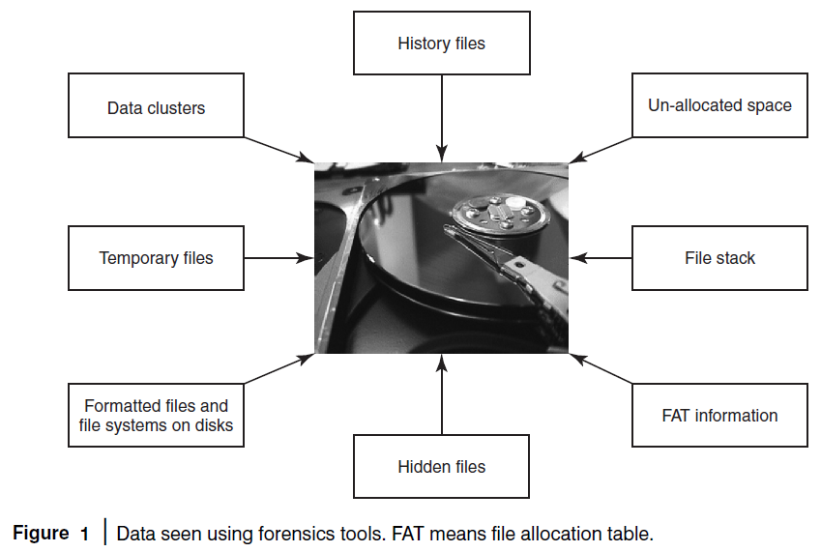

Slide 5
Digital Forensics Life Cycle
As per FBI’s (Federal Bureau of Investigation) view, digital evidence is present in nearly every crime scene. That is why law enforcement must know how to recognize, seize, transport and store original digital evidence to preserve it for forensics examination.
Digital Forensics Process
Digital forensics evidence consists of exhibits.
The exhibits are introduced as evidence by either side.
Testimony is presented to establish the process.
The party must show the evidence.
Digital forensics evidence can be challenged.
Forensics experts formulate a cost proposal.
Proposed timeline of activities, lists of anticipated deliverables and a plan for production and turnover of evidence.
Submission of a preliminary risk analysis for the forensics service being proposed.

Slide 6
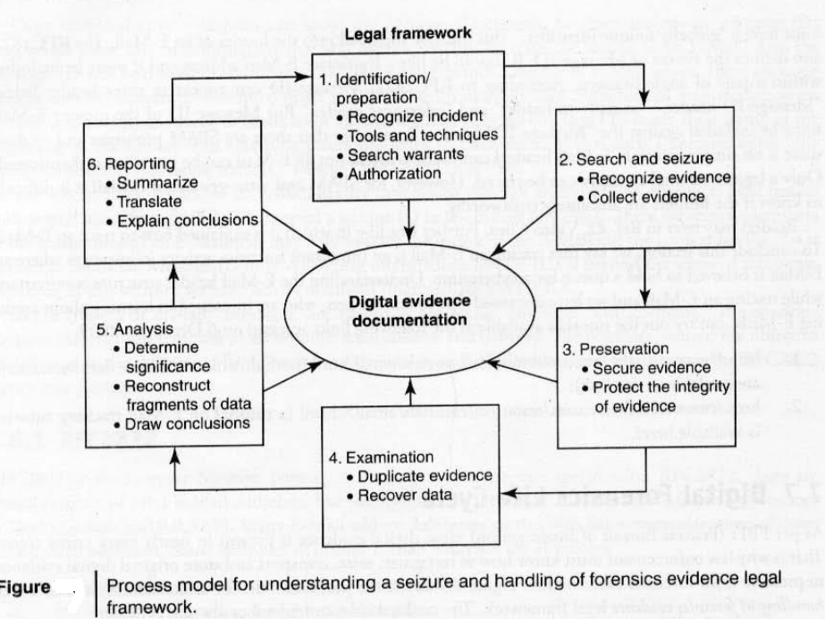
Digital Forensics Process

Slide 7
Phases in Computer Forensics/Digital Forensics
1. Preparation and identification
2. Collection and recording
3. Storing and transporting
4. Examination/investigation
5. Analysis, interpretation and attribution
6. Reporting
7. Testifying

Slide 8
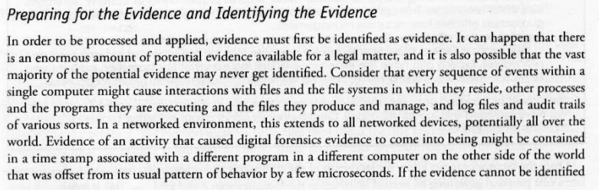
Phases in Computer Forensics/Digital Forensics
1.

Slide 9
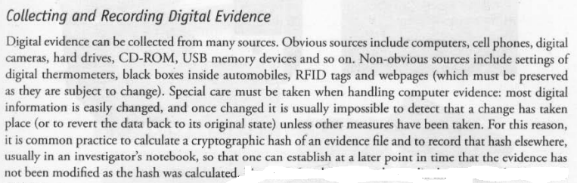
Phases in Computer Forensics/Digital Forensics
2.

Slide 10
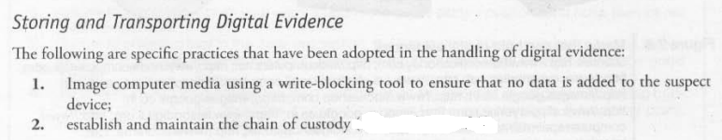
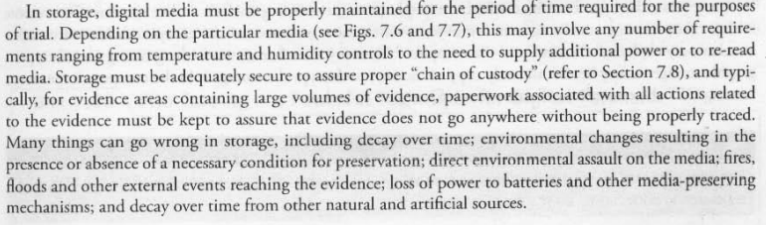
Phases in Computer Forensics/Digital Forensics
3.

Slide 11
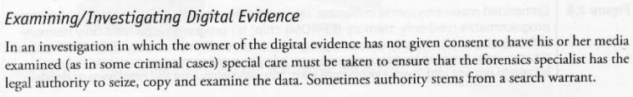
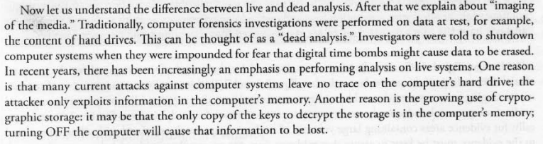
Phases in Computer Forensics/Digital Forensics
4.

Slide 12
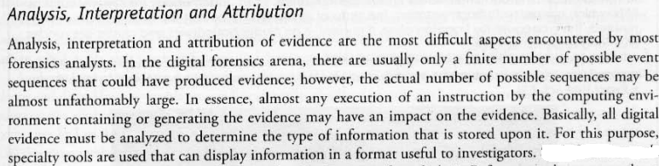

Phases in Computer Forensics/Digital Forensics
5.

Slide 13
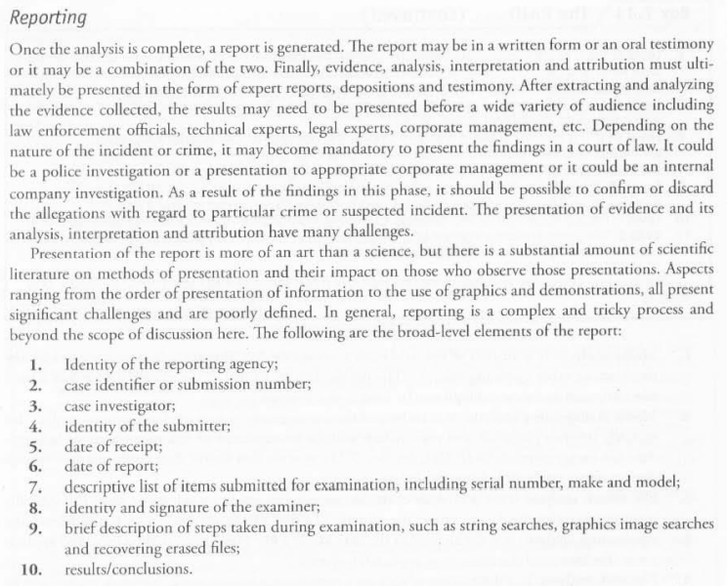
Phases in Computer Forensics/Digital Forensics
6.

Slide 14
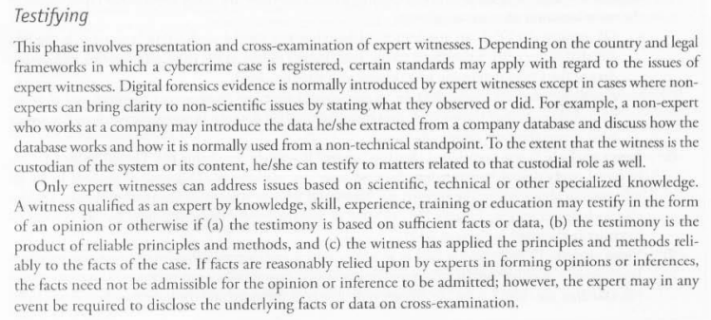
Phases in Computer Forensics/Digital Forensics
7.

Slide 15
Questions
Describe the terms Digital Forensics Science and Computer Forensics
Explain the data seen using forensic tools.
Describe the digital forensics process.
What are the various phases and activities involved in the life cycle of a forensics investigation process? Support with relevant example.

